Slide 1

Task Week 2 & Week 3
Dian Rahmadani

Slide 2
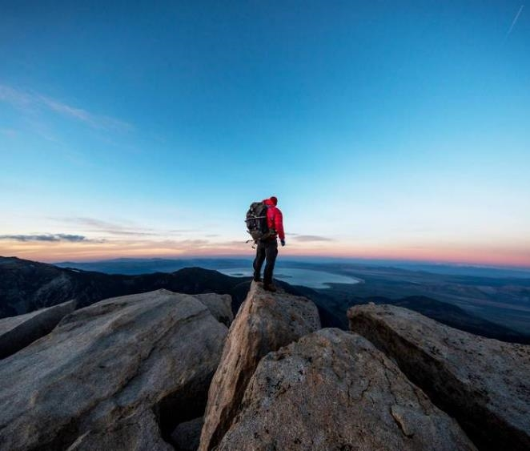

Intro
Full Name: Dian Rahmadani
Domicile: Tarakan, Kalimantan Utara
Batch: 12
Task: Week 2 & Week 3

Slide 3
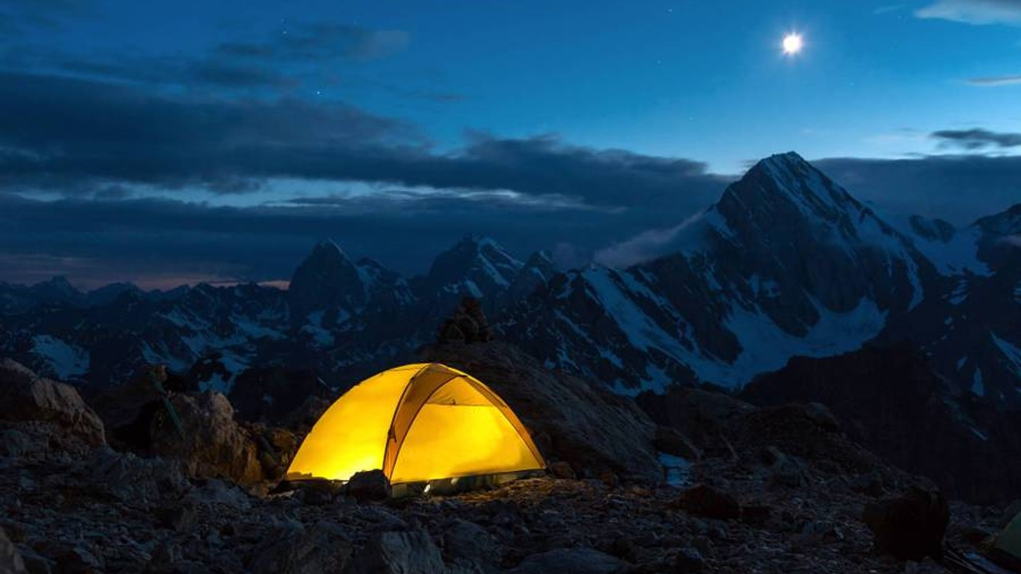
First, solve the problem. Then, write the code.
John Johnson

Slide 4


Thank you
Dian Rahmadani
madiajijah7@gmail.com
madiajijah11.github.io

